Slide 1
Universality of
NAND & NOR Gates

Slide 2
What are a Universal Gate ? Why NAND and NOR are known as universal gates?
A gate which can be used to create any Logic gate is called Universal Gate.
NAND and NOR are called Universal Gates because all the other gates can be created by using these gates.

Slide 3
NAND as Universal Gates
Implementation of NOT using NAND
Desired [not gate]
F = A’
Available [Nand gate]
F = (A)’
F = A’

Slide 4

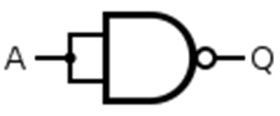
NAND as Universal Gates
Implementation of NOT using NAND
A NOT gate is made by joining the inputs of a NAND gate together.
Desired NOT Gate
NOT using NAND

Slide 5
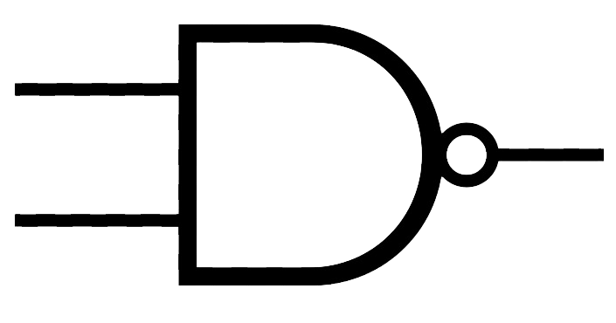
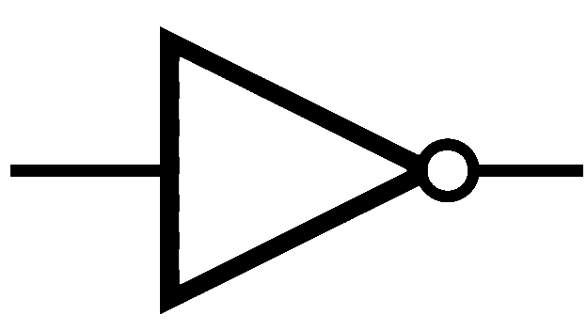
NAND as Universal Gates
Implementation of AND using NAND
Available[NAND gate]
F=(A.B)’
To achieve AND gate;
F=[(A.B)’]’
F= A.B
Desired [AND gate]
F=A.B
A
B
(A.B)’
[(A.B)’]’ = A.B

Slide 6

NAND as Universal Gates
An AND gate is made by following a NAND gate with a NOT gate(using NAND)
Implementation of AND using NAND
AND using NAND

Slide 7
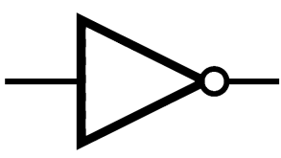
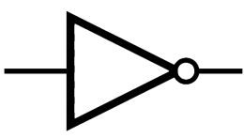
NAND as Universal Gates
Implementation of OR using NAND
Available[NAND gate]
F(A,B)=(A.B)’
= A’+B’
F(A’,B’)=(A’.B’)’
= A+B
Desired [OR gate]
F=A+B
A’
B’
A
B
(A’.B’)’
= A+B

Slide 8
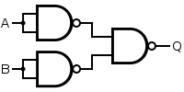
NAND as Universal Gates
Implementation of OR using NAND
An OR gate is made by inverting the inputs to a NAND gate.
OR using NAND

Slide 9
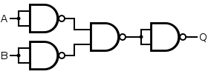
NAND as Universal Gates
Implementation of NOR using NAND
A NOR gate is simply an inverted OR gate. So, we add NOT gate(using NAND) to OR gate made using NAND gates.
NOR using NAND

Slide 10
NOR as Universal Gates
Implementation of NOT using NOR
Desired [not gate]
F = A’
Available [Nor gate]
F (A,A)= (A+A)’
F = A’

Slide 11


NOR as Universal Gates
Implementation of NOT using NOR
NOT made by joining the inputs of a NOR gate.
NOR Gate
NOT using NOR

Slide 12
NOR as Universal Gates
Implementation of OR using NOR
Desired [Or gate]
F = A+B
Available [NOR gate]
F = (A+B)’
F = [(A+B)’]’
F = (A+B)

Slide 13

NOR as Universal Gates
Implementation of OR using NOR
The OR gate is simply a NOR gate followed by another
NOR gate
OR using NOR

Slide 14
NOR as Universal Gates
Implementation of AND using NOR
Desired [AND gate]
F = A.B
Available [NOR gate]
F(A,B) = (A+B)’
F = A’.B’
F(A’,B’) = (A’+B’)’
F = A.B

Slide 15
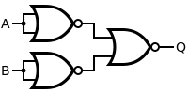
NOR as Universal Gates
Implementation of AND using NOR
An AND gate is made by inverting the inputs to a NOR gate.
A’
=(A’+B’)’
Q = A.B
B’
AND using NOR

Slide 16
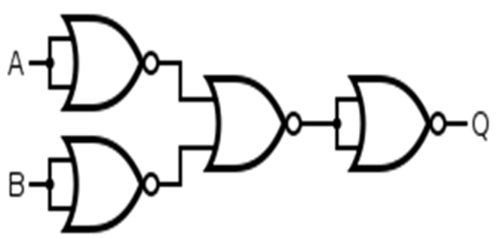
NOR as Universal Gates
Implementation of NAND using NOR
A NAND gate is simply an inverted AND gate. So, we add NOT gate(using NOR) to AND gate made using NOR gates.
F= A.B
= (A.B)’
NAND using NOR

Slide 17
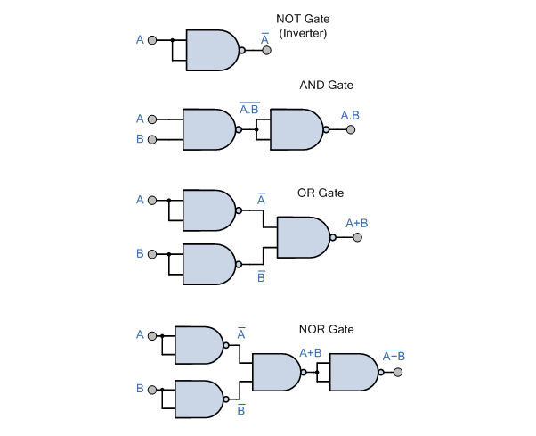
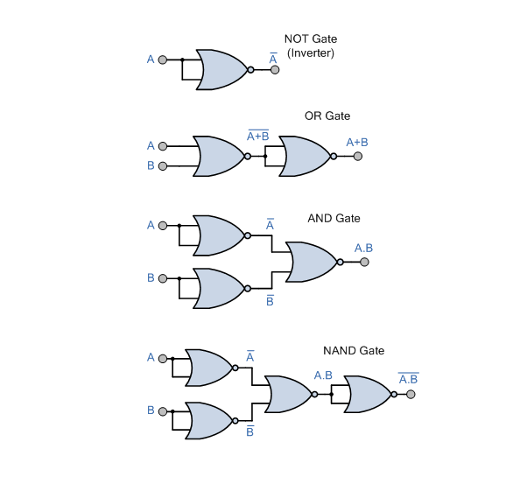
Summary

Slide 18


NAND and NOR Implementation
NAND Implementation
1. Draw the logic diagram using basic gates. Assume both forms of wires are available.
2. Replace all the the AND gates using AND-invert symbol.
3. Replace all the OR gates using invert-OR symbol.
4. Cancel all the circles(inverters) in the same line. If any circle is remaining, replace it
using Inverter of NAND gate.
5. Replace all the remaining gates with AND-invert symbol.
A
B
A
B
A’ +B’
(A.B)’ = A’+B’
Invert-OR
AND-invert

Slide 19
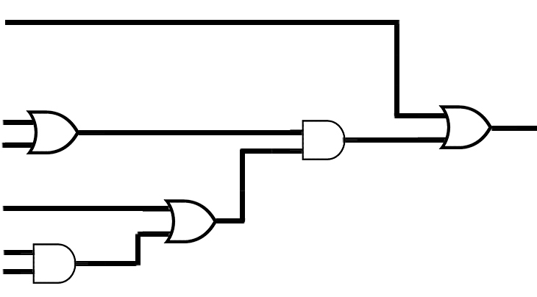
NAND and NOR Implementation
NAND Implementation
Implement the Boolean function F = A+(B’+C)(D’+BE’) using NAND gates only.
Step 1
Draw the logic diagram using basic gates. Assume both forms of wires are available.
A
B’
C
D’
B
E’
F=A+(B’+C)(D+BE’)
B’+C
(B’+C)(D+BE’)
D+BE’
BE’

Slide 20
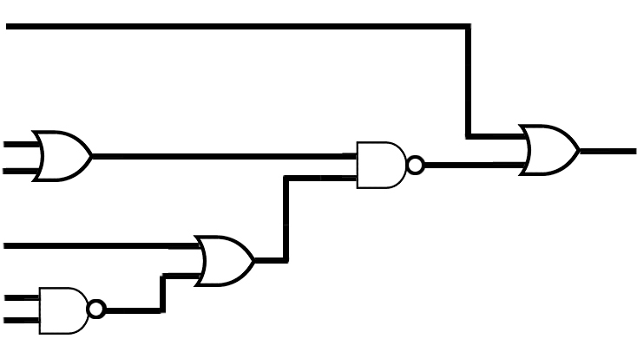
NAND and NOR Implementation
Step 2
Replace all the AND gates using AND-invert symbol.
A
B’
C
D’
B
E’

Slide 21
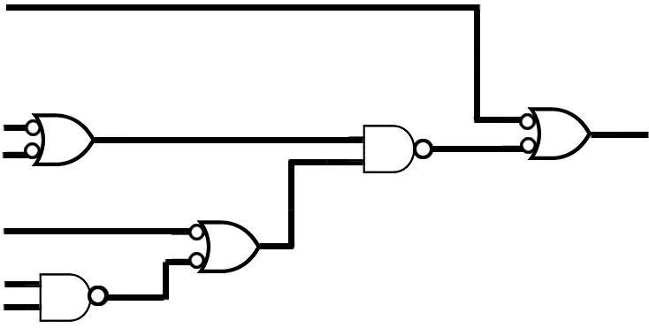
NAND and NOR Implementation
Step 3
Replace all the OR gates using invert-OR symbol.
A
B’
C
D’
B
E’

Slide 22
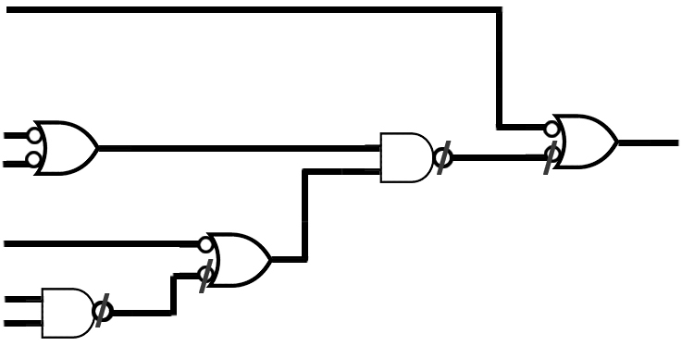
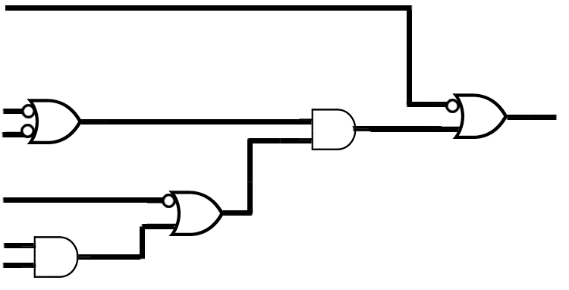
NAND and NOR Implementation
Step 4
Cancel all the circles in the same line.
A
B’
C
D’
B
E’
A
B’
C
D’
B
E’

Slide 23
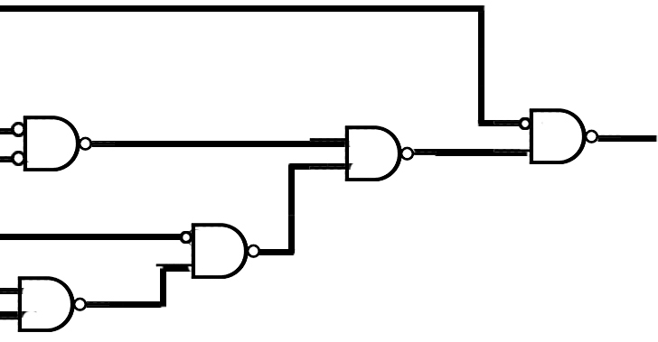
NAND and NOR Implementation
Step 5
Replace all the remaining gates with AND-invert gates.
.
A
B’
C
D’
B
E’

Slide 24
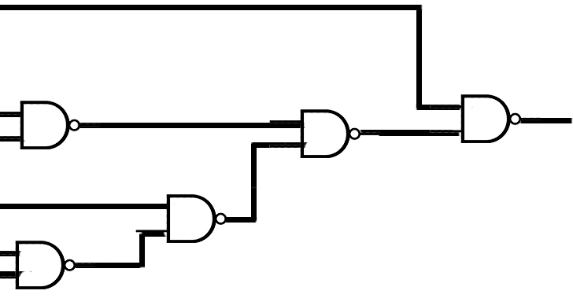
NAND and NOR Implementation
Step 6
Simply, replace remaining circles with complementing the input or replace it with an inverter using NAND gate.
.
A’
B
C’
D
B
E’

Slide 25
NAND and NOR Implementation
Finally, verify the output.
A’
B
C’
D
B
E’
F = A+(B’+C)(D’+BE’)
T1
T4
T3
T2

Slide 26
NAND and NOR Implementation
Finally, verify the output.
T1 = (B.C’)’ = B’+C
T2 = (B.E’)’ = B’+E
T3 = (D.T2)’ = D’+T2’
T4 = (T1.T3)’ = T1’+T3’ = (B’+C)’ + (D’+T2’)’
= (B’+C)’ + (D’+(B’+E)’)’
= (B’+C)’ + (D’+B.E’)’
F = (A’ .T4)’ = A + T4’
= A+[(B’+C)’+(D’+BE’)’]’
= A+(B’+C). (D’+BE’)

Slide 27
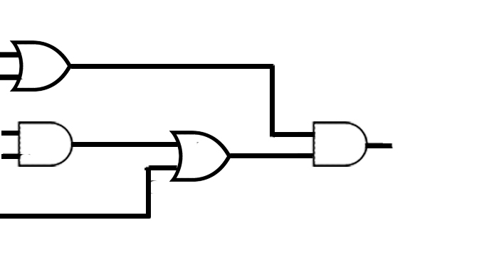
NAND and NOR Implementation
Implement the Boolean function F = (A+B’)(CD+E)using NAND gates only.
A+B’
A
B’
C
D
E
F =(A+B’).(C.D+E)
C.D
C.D+E

Slide 28
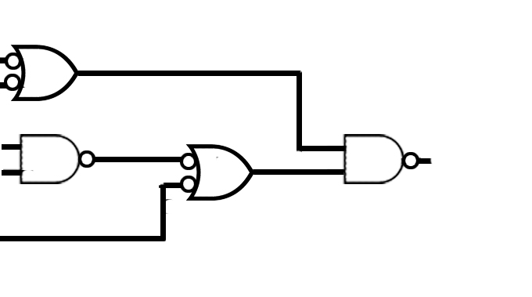
NAND and NOR Implementation
Implement the Boolean function F = (A+B’)(CD+E)using NAND gates only.
A
B’
C
D
E

Slide 29

NAND and NOR Implementation
Implement the Boolean function F = (A+B’)(CD+E)using NAND gates only.
A
B’
C
D
E

Slide 30
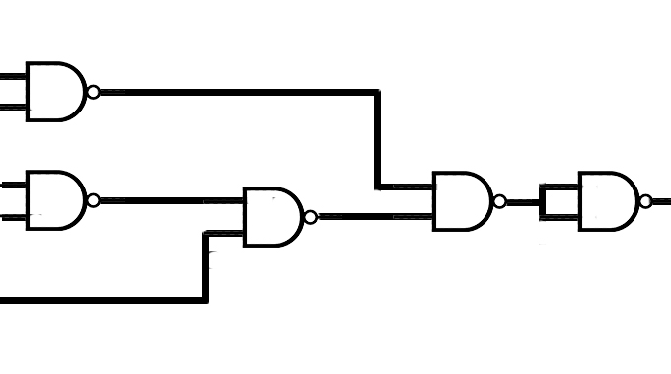
NAND and NOR Implementation
Implement the Boolean function F = (A+B’)(CD+E)using NAND gates only.
A’
B
C
D
E’
F1
F4
F
F2
F3

Slide 31
NAND and NOR Implementation
Implement the Boolean function F = (A+B’)(CD+E)using NAND gates only.
F1 = (A’.B)’ = A+B’
F2 = (C.D)’ = C’+D’
F3 = (F2.E’)’ = F2’+E
= C.D+E
F4 = (F1.F3)’ = F1’ + F3’
=(A’.B) + (C.D+E)’
=(A’.B) + ((C.D)’ . E’)
=(A’.B) + ((C’+D’) . E’)
F = F4’ = [(A’.B) + ((C’+D’) . E’)]’
= (A’.B)’ . (C’+D’)’ + E
= A+B’ . (C.D) + E
= (A+B’)(CD+E)

Slide 32
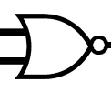

NAND and NOR Implementation
NOR Implementation
1. Draw the logic diagram using basic gates. Assume both forms of wires are available.
2. Replace all the the OR gates using OR-invert symbol.
3. Replace all the AND gates using invert-AND symbol.
4. Cancel all the circles in the same line. If any circle is remaining, replace it using
Inverter of NOR gate.
5. Replace all the remaining gates with OR-invert signal.
OR-invert
invert-AND

Slide 33
NAND and NOR Implementation
NOR Implementation
Implement the Boolean function F = A+(B’+C)(D’+BE’) using NOR gates only.
Step 1
Draw the logic diagram using basic gates. Assume both forms of wires are available.
A
B’
C
D’
B
E’
F=A+(B’+C)(D+BE’)
B’+C
(B’+C)(D+BE’)
D+BE’
BE’

Slide 34
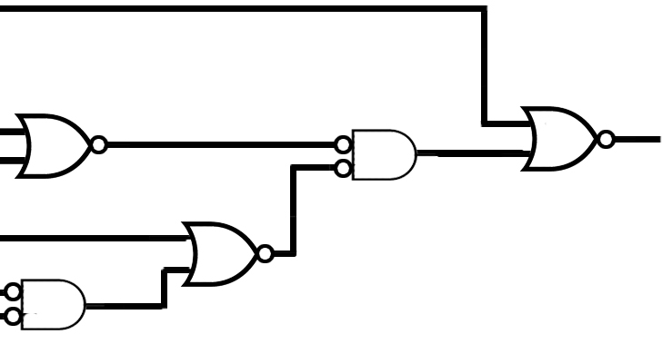
NAND and NOR Implementation
Step 2
Replace all the AND gates using invert-AND symbol & OR with OR-invert symbol
A
B’
C
D’
B
E’

Slide 35
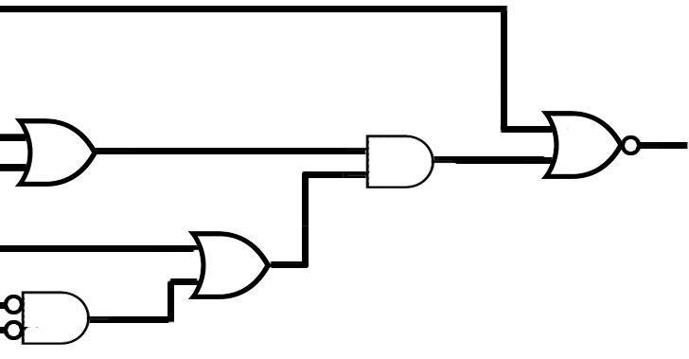
NAND and NOR Implementation
Step 3
Cancel all the circles in the same line.
A
B’
C
D’
B
E’

Slide 36
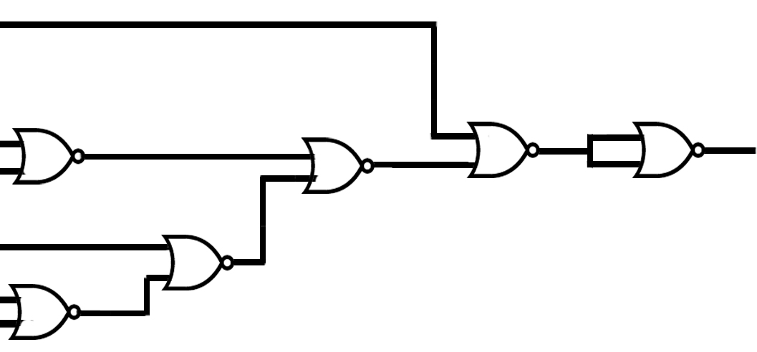
NAND and NOR Implementation
Step 4
Remove the remaining circles using inverters(using NOR) and replace all the gates with OR-invert.
A
B’
C
D’
B’
E
T1
T
T4
T5
T3
T2

Slide 37
NAND and NOR Implementation
Implement the Boolean function F = (A+B’)(CD+E) using NOR gates only.
Implement the Boolean function F = A’B + AB’ using NOR only and NAND only.
Implement the Boolean function F = AB + A’B’ using NOR only and NAND only.

